Slide 1


Slide 2
Computer Organization
Computer Organization - It tells us how exactly all the units in the system are arranged and interconnected.
deals with components of a connection in a system.
Computer Architecture – It helps us to understand the functionalities of a system.

Slide 3
Computer Architecture
Computer Architecture means what a computer can do.
It describes:
Instruction set (ADD, SUB, MOV, etc.)
Data types
Addressing modes
Number of bits (8-bit, 32-bit, 64-bit)
How a programmer sees the computer
It is visible to the programmer.

Slide 4
Computer Organization
Computer Organization means how the computer actually does it.
It explains:
How registers are connected
How ALU works
How data moves on buses
Control unit and timing
Hardware implementation
It is visible to the hardware designer, not the programmer.

Slide 5
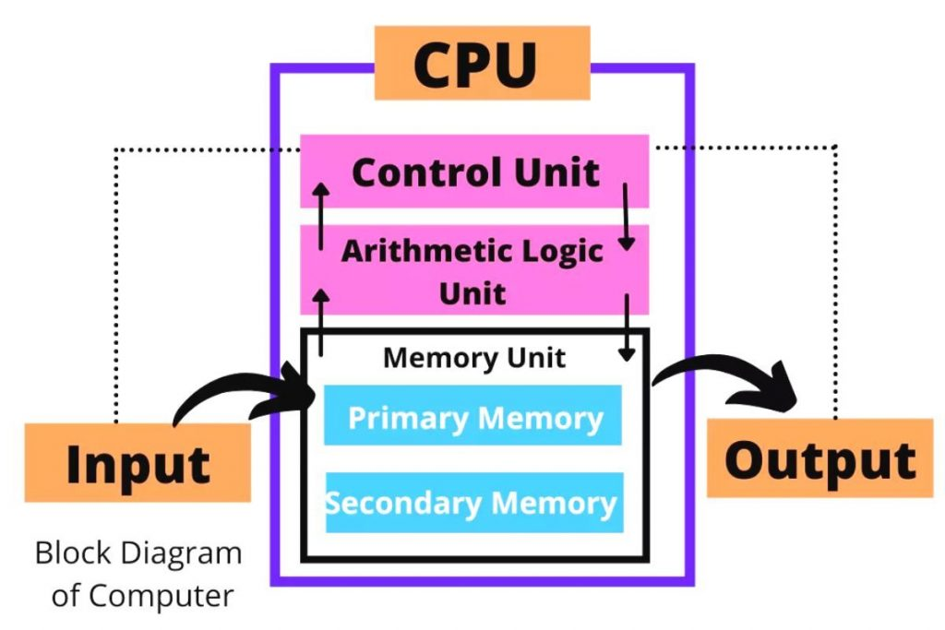
Basic Organization of a Computer

Slide 6
Input Unit
Output Unit
Central Processing Unit (CPU)
Control Unit (CU)
Arithmetic And Logic Unit (ALU)
Memory Unit - (i)Primary memory (ii)Secondary memory

Slide 7
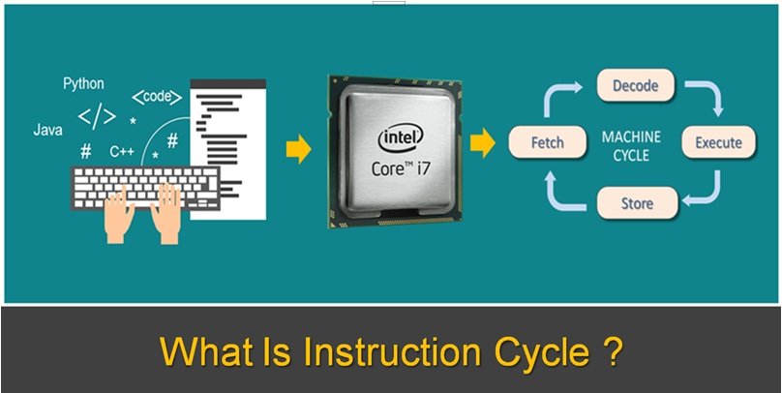
Example
Instruction Cycle

Slide 8
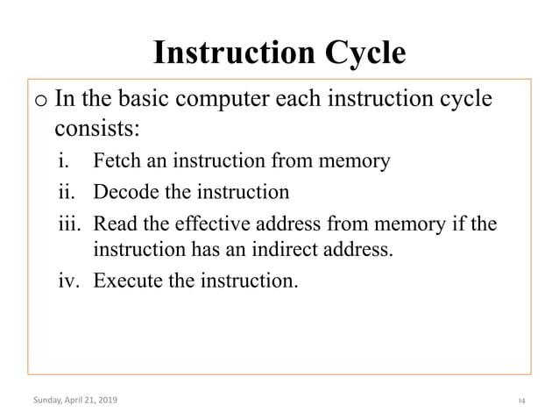

Slide 9
Overview
Instruction Codes
Computer Registers
Computer Instructions
Common Bus System
Timing and Control
Instruction Cycle
Memory Reference Instructions
Input-Output and Interrupt
Complete Computer Description
CSE 211, Computer Organization and Architecture

Slide 10
Introduction
Every different processor type has its own design (different registers, buses, microoperations, machine instructions, etc)
Modern processor is a very complex device
It contains
Many registers
Multiple arithmetic units, for both integer and floating point calculations
The ability to pipeline several consecutive instructions to speed execution
Etc.
However, to understand how processors work, we will start with a simplified processor model

Slide 11
Basic Computer
The Basic Computer has two components, a processor and memory
The memory has 4096 words in it
4096 = 2¹², so it takes 12 bits to select a word in memory
Each word is 16 bits long
CPU
RAM
0
4095
15
0

Slide 12
Instruction
Program
A sequence of (machine) instructions
(Machine) Instruction
A group of bits that tell the computer to perform a specific operation (a sequence of micro-operation)
The instructions of a program, along with any needed data are stored in memory
CSE 211, Computer Organization and Architecture

Slide 13
Instruction
The CPU reads the next instruction from memory
It is placed in an Instruction Register (IR)
Control circuitry in control unit then translates the instruction into the sequence of microoperations
It is very necessary to implement it
CSE 211, Computer Organization and Architecture

Slide 14
Instruction Format
A computer instruction is often divided into two parts
An opcode (Operation Code) that specifies the operation for that instruction
An address that specifies the registers and/or locations in memory to use for that operation
In the Basic Computer, since the memory contains 4096 (= 2¹²) words,
we needs 12 bit to specify which memory address this instruction will use
Instruction Format
15
14
12
11
0
I
Opcode
Address
Addressing
mode
CSE 211, Computer Organization and Architecture

Slide 15
Instruction Format
In the Basic Computer,
15 bit of the instruction specifies the addressing mode
(0: direct addressing, 1: indirect addressing)
Since the memory words, and hence the instructions, are 16 bits long, that leaves 3 bits for the instruction’s opcode
Instruction Format
15
14
12
11
0
I
Opcode
Address
Addressing
mode
CSE 211, Computer Organization and Architecture

Slide 16
Addressing Mode
The address field of an instruction can represent either
Direct address: the address in memory of the data to use (the address of the operand), or
Indirect address: the address in memory of the address in memory of the data to use
Effective Address (EA)
The address, that can be directly used without modification to access an operand for a computation-type instruction, or as the target address for a branch-type instruction
Direct addressing
Indirect addressing
22
0
ADD
457
35
1
ADD
300
300
1350
457
Operand
1350
Operand
+
+
AC
AC
CSE 211, Computer Organization and Architecture

Slide 17
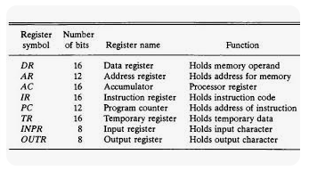
Processor Registers

Slide 18
Processor Register
A processor has many registers to hold instructions, addresses, data, etc
The processor has a register, the Program Counter (PC) that holds the memory address of the next instruction to get
Since the memory in the Basic Computer only has 4096 locations, the PC only needs 12 bits
CSE 211, Computer Organization and Architecture

Slide 19
Processor Register
In a direct or indirect addressing, the processor needs to keep track of what locations in memory it is addressing:
The Address Register (AR) is used for this
The AR is a 12 bit register in the Basic Computer
When an operand is found, using either direct or indirect addressing, it is placed in the Data Register (DR).
The processor then uses this value as data for its operation
The Basic Computer has a single general purpose register – the Accumulator (AC)
CSE 211, Computer Organization and Architecture

Slide 20
Processor Register
The significance of a general purpose register is that it can be referred to in instructions
e.g. load AC with the contents of a specific memory location; store the contents of AC into a specified memory location
Often a processor will need a scratch register to store intermediate results or other temporary data;
in the Basic Computer this is the Temporary Register (TR)
CSE 211, Computer Organization and Architecture

Slide 21
Processor Register
The Basic Computer uses a very simple model of input/output (I/O) operations
Input devices are considered to send 8 bits of character data to the processor
The processor can send 8 bits of character data to output devices
The Input Register (INPR) holds an 8 bit character gotten from an input device
The Output Register (OUTR) holds an 8 bit character to be send to an output device
CSE 211, Computer Organization and Architecture

Slide 22
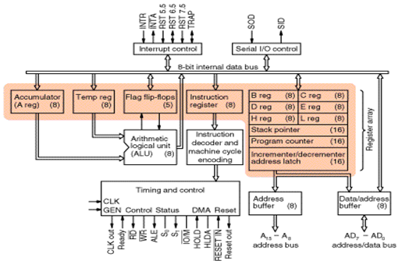
Internal architecture of the Intel 8085

Slide 23
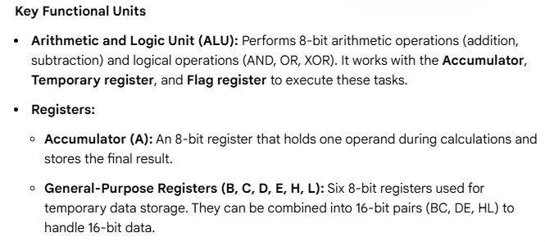
Internal architecture of the Intel 8085

Slide 24
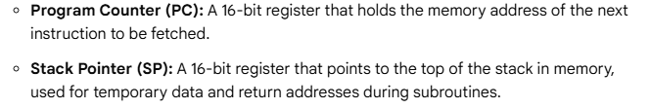
Internal architecture of the Intel 8085
Registers:

Slide 25
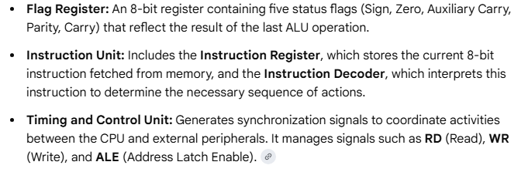

Slide 26
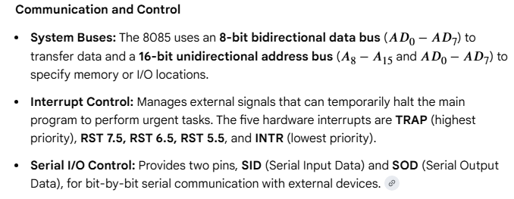

Slide 27
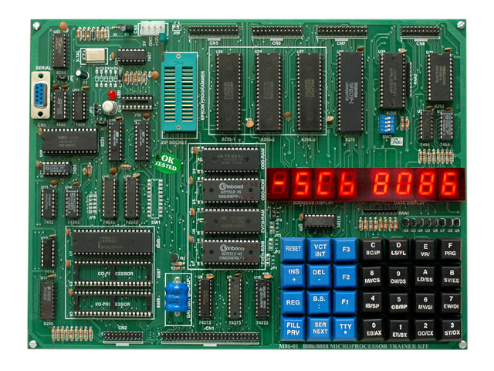

Slide 28
Processor Register
Registers in the Basic Computer
11
0
PC
Memory
11
0
4096 x 16
AR
15
0
IR
CPU
15
0
15
0
TR
DR
7
0
7
0
15
0
OUTR
INPR
AC
List of BC Registers
DR 16 Data Register Holds memory operand
AR 12 Address Register Holds address for memory
AC 16 Accumulator Processor register
IR 16 Instruction Register Holds instruction code
PC 12 Program Counter Holds address of instruction
TR 16 Temporary Register Holds temporary data
INPR 8 Input Register Holds input character
OUTR 8 Output Register Holds output character
CSE 211, Computer Organization and Architecture

Slide 29
Common Bus System
The registers in the Basic Computer are connected using a bus
This provide a savings/optimization in circuitry over complete connections between registers
CSE 211, Computer Organization and Architecture

Slide 30
Common Bus System
S1
Bus
S0
Memory unit
7
4096 x 16
Address
Write
Read
AR
1
LD INR CLR
PC
2
LD INR CLR
DR
3
LD INR CLR
E
ALU
AC
4
LD INR CLR
INPR
IR
5
LD
TR
6
LD INR CLR
OUTR
Clock
LD
CSE 211, Computer Organization and Architecture

Slide 31
Common Bus System
Three control lines, S₂, S₁, and S₀ control which register the bus selects as its input
Either one of the registers will have its load signal activated, or the memory will have its read signal activated
Will determine where the data from the bus gets loaded
S₂ S₁ S₀ Register
0 0 0 x
0 0 1 AR
0 1 0 PC
0 1 1 DR
1 0 0 AC
1 0 1 IR
1 1 0 TR
1 1 1 Memory
CSE 211, Computer Organization and Architecture

Slide 32
Common Bus System
Either one of the registers will have its load signal activated, or the memory will have its read signal activated
Will determine where the data from the bus gets loaded
The 12-bit registers, AR and PC, have 0’s loaded onto the bus in the high order 4 bit positions
When the 8-bit register OUTR is loaded from the bus, the data comes from the low order 8 bits on the bus
CSE 211, Computer Organization and Architecture

Slide 33
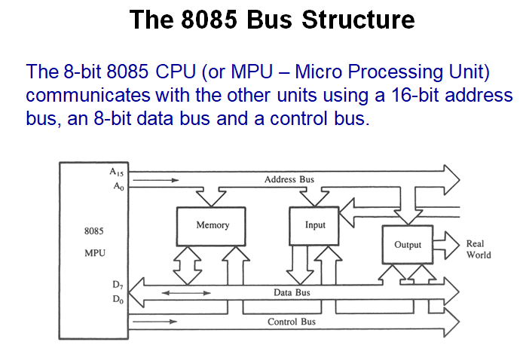

Slide 34
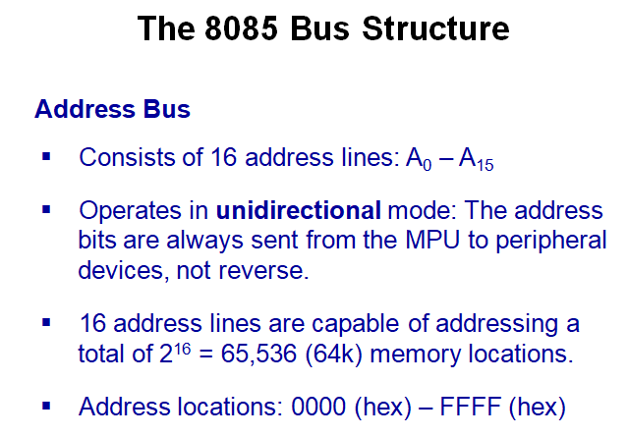

Slide 35
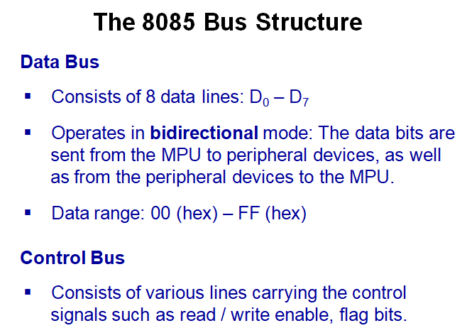

Slide 36
Basic Computer Instructions
Basic Computer Instruction Format
1. Memory-Reference Instructions (OP-code = 000 ~ 110)
15 14
12 11
0
I
Opcode
Address
2. Register-Reference Instructions (OP-code = 111, I = 0)
15
12 11
0
0 1 1 1
Register operation
3. Input-Output Instructions (OP-code =111, I = 1)
15
12 11
0
1 1 1 1
I/O operation
CSE 211, Computer Organization and Architecture

Slide 37
Machine Instruction
A machine instruction is a group of bits (0s and 1s) that tells the computer what operation to perform.
Each instruction is written in binary form, which the CPU can understand.
When executed, one machine instruction is broken down into a sequence of micro-operations
Micro-operations are small internal steps like:
Fetching data
Moving data between registers
Performing arithmetic or logic operations
Example: An ADD instruction internally performs multiple micro-operations such as loading operands, adding them, and storing the result.

Slide 38
Instruction
The CPU fetches the next instruction from the main memory.
This fetched instruction is stored in the Instruction Register (IR).
The Control Unit (CU) then decodes the instruction.
After decoding, the control circuitry translates the instruction into a sequence of micro-operations.
These micro-operations generate control signals that coordinate the CPU components to execute the instruction.
After decoding, the control circuitry translates the instruction into a sequence of micro-operations.
CSE 211, Computer Organization and Architecture

Slide 39
1. Opcode (Operation Code)
The opcode specifies what operation the computer has to perform
Examples of operations:
ADD
SUB
LOAD
STORE
JUMP
2. Address (Operand / Address Field)
The address field specifies where the data is located
It may point to:
A register
A memory location

Slide 40
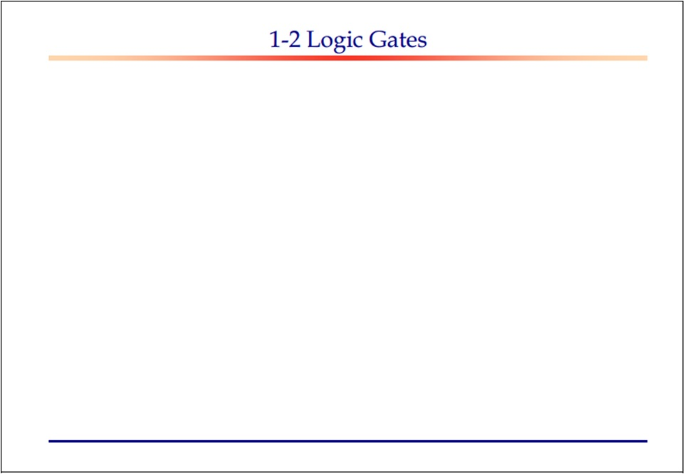
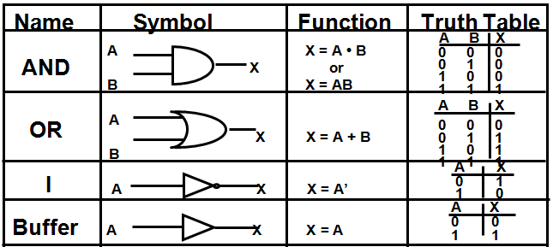

Slide 41
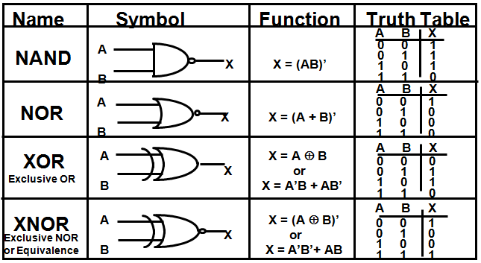

Slide 42
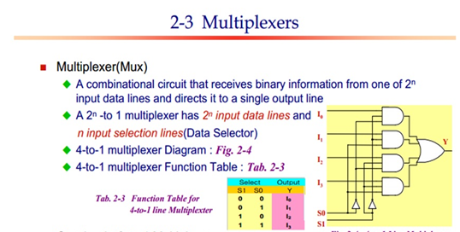

Slide 43
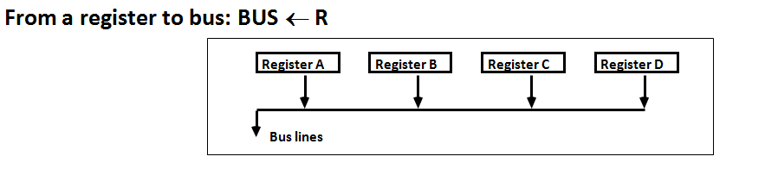
Register Transfer and Micro-operations 43
Connecting Registers - Bus Transfer
One way of constructing common bus system is with multiplexers
Multiplexer selects the source register whose binary information is kept on the bus.
Construction of bus system for 4 register (Next Fig)
4 bit register X 4
four 4X1 multiplexer
Bus selection S0, S1
CSE 211

Slide 44
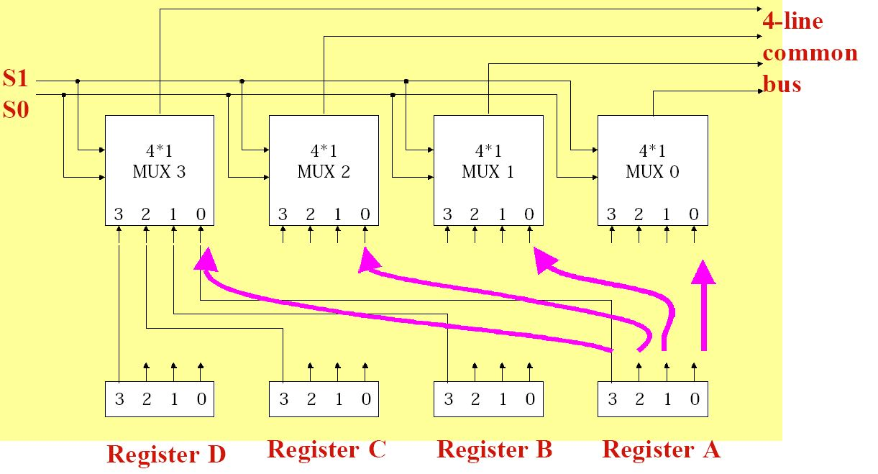
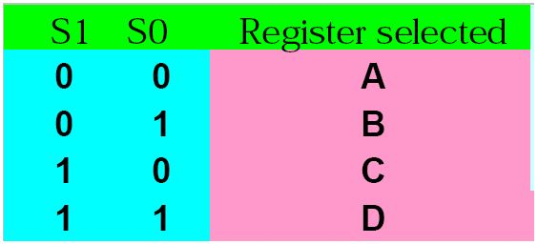
Register Transfer and Micro-operations 44
Connecting Registers - Bus Transfer
CSE 211

Slide 45
Basic Computer Instructions
Hex Code
Symbol I = 0 I = 1 Description
AND 0xxx 8xxx AND memory word to AC
ADD 1xxx 9xxx Add memory word to AC
LDA 2xxx Axxx Load AC from memory
STA 3xxx Bxxx Store content of AC into memory
BUN 4xxx Cxxx Branch unconditionally
BSA 5xxx Dxxx Branch and save return address
ISZ 6xxx Exxx Increment and skip if zero
CLA 7800 Clear AC
CLE 7400 Clear E
CMA 7200 Complement AC
CME 7100 Complement E
CIR 7080 Circulate right AC and E
CIL 7040 Circulate left AC and E
INC 7020 Increment AC
SPA 7010 Skip next instr. if AC is positive
SNA 7008 Skip next instr. if AC is negative
SZA 7004 Skip next instr. if AC is zero
SZE 7002 Skip next instr. if E is zero
HLT 7001 Halt computer
INP F800 Input character to AC
OUT F400 Output character from AC
SKI F200 Skip on input flag
SKO F100 Skip on output flag
ION F080 Interrupt on
IOF F040 Interrupt off
CSE 211, Computer Organization and Architecture

Slide 46
Instruction Set Completeness
A computer should have a set of instructions so that the user can construct machine language programs to evaluate any function that is known to be computable.
Instruction Types
Functional Instructions
- Arithmetic, logic, and shift instructions
- ADD, CMA, INC, CIR, CIL, AND, CLA
Transfer Instructions
- Data transfers between the main memory and the processor registers
- LDA, STA
Control Instructions
- Program sequencing and control
- BUN, BSA, ISZ
Input/output Instructions
- Input and output
- INP, OUT
CSE 211, Computer Organization and Architecture

Slide 47
Classification of Instruction Set
Data transfer operation
Arithmetic and Logic operation
Logical operation
Branching operation
Machine-control operation

Slide 48

1. Date Transfer or Copy Operations
MOV: Copy from source to destination
Examples: mov B, A ;A is copied to B
mov M, B ;content of B is copied to address
location pointed by content of HL
pair
mov C, M ;content of address location
pointed by HL pair is copied to C
Conti…

Slide 49
1. Date Transfer Operations (Conti….)
MVI: Move immediately 8-bit
Examples: mvi B, 44h ;44h is copied to B
mvi M, A2h ;A2h is copied to address location
pointed by content of HL pair
LXI: Load register pair immediately
Example: lxi B, 1234h ;loads 12h in B & 34h in C
Conti…
SHLD: Store HL register directly
Example: shld 8500h ;L to 8500h & H to 8501

Slide 50
1. Date Transfer Operations (Conti….)
LDA: Load accumulator directly
Example: lda 8501h ;content of memory pointed by
8501h is copied to A
STA: Store accumulator directly
Example: sta 8501h ;A is copied to memory location
8501h
LHLD: Load HL register directly
Example: lhld 8500h ;content of 8500h is copied to
L & 8501 to H
SHLD: Store HL register directly
Example: shld 8550h ;L is copied to 8550h andH is
copied to 8551h
Conti…

Slide 51
1. Date Transfer Operations (Conti….)
LDAX: Load accumulator indirectly
Example: ldax B ;content of memory pointed by
content of BC is copied to A
STAX: Store accumulator indirectly
Example: stax B ;content of A is copied to memory
pointed by address location made
of BC
XCHG: Exchange HL with DE
Example: xchg ;the content of H & D and
L & E are exchanged

Slide 52

2. Arithmetic Operations
ADD: Add register to accumulator
Examples: add B ;B is added with A & stored at A
add M ;content of memory location
pointed by content of HL pair
is added with A & stored at A
ADI: Add immediately to accumulator
Example: adi 22h ;22h is added with A & stored at A
Conti…

Slide 53
2. Arithmetic Operations (Conti….)
ADC: Add register to accumulator with carry
Examples: adc B ;content of B and carry is
is added with A & stored at A
adc M ;content of memory location
pointed by HL pair and carry
is added with A & stored at A
ACI: Add immediately to accumulator with carry
Example: aci 22h ;22h and carry is added with
A & stored at A
Conti…

Slide 54
2. Arithmetic Operations (Conti….)
SBB: Subtract source and borrow from accumulator
Examples: sbb D ;D and borrow “Cy” subtracted
from A & stored at A
sbb M ;content of memory location
pointed by HL pair and
borrow “Cy” is subtracted from
A & stored at A
SBI: Subtract immediately with borrow
Example: sbi 22h ;22h and borrow ‘Cy” is subtracted
from A & stored at A
Conti…

Slide 55
2. Arithmetic Operations (Conti….)
INR: Increment content of register/memory by 1
Examples: inr E ;content of E incremented by 1
inr M ;content of memory pointed by
HL pair is incremented by 1
DCR: Decrement source by 1
Examples: dcr B ;content of B is decremented by 1
dcr M ;content of memory pointed by
HL pair is incremented by 1
INX: Increment register pair by 1
Example: inx B ;increment content of BC register
by 1 & stored at same location
Conti…

Slide 56
2. Arithmetic Operations (Conti….)
DCX: Decrement register pair by 1
Example: dcx D ;decrement content of DE register
by 1 & stored at same location
DAD: Add register pair to HL register pair
Example: dad D ;content of DE pair is added with
content of HL pair & stored
at HL pair
This is a 16-bit addition.
DAA: Decimal adjust accumulator
Example: add B
daa ;converts binary format into
BCD format
It adds 0110 if forbidden bit arises.

Slide 57
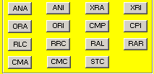
3. Logical Operations
ANA: Logical AND with accumulator
Examples: ana B ;B and A is ANDed & stored at A
ana M ;content of memory pointed by HL
pair and A is ANDed & stored at A
ANI: AND immediately with accumulator
Example: ani 44h ;44h and A is ANDed & stored at A
Conti…

Slide 58
3. Logical Operations (Conti……)
XRA: Exclusive OR with accumulator
Examples: xra D ;D and A is XORed & stored at A
xra M ;content of memory location
pointed by HL pair is XORed with
A & stored at A
XRI: Exlusive OR immediately with accumulator
Example: xri AAh ;AAh and A is XORed & stored at A
ORA: Logical OR with accumulator
Examples: ora B ;B and A is ORed & stored at A
ora M ;content of memory location
pointed by HL pair is ORed with
A & stored at A
Conti…

Slide 59
3. Logical Operations (Conti……)
ORI: Logically OR immediately
Example: ori 44h ;44h and A ORed & stored at A
CMP: Compare with accumulator
Examples: cmp B ;B is compared with A
if A>B, Z=0, Cy=0
if A=B, Z=1, Cy=0
if A<B, Z=0, Cy=1
cmp M ;A is compared with content of
memory location pointed by HL
CPI: Compare immediately with accumulator
Example: cpi 44h ;44h is compared with A
Conti…

Slide 60
Control Unit
Control unit (CU) of a processor translates from machine instructions to the control signals for the microoperations that implement them
Control units are implemented in one of two ways
Hardwired Control
CU is made up of sequential and combinational circuits to generate the control signals
Microprogrammed Control
A control memory on the processor contains microprograms that activate the necessary control signals
We will consider a hardwired implementation of the control unit for the Basic Computer
CSE 211, Computer Organization and Architecture

Slide 61

4. Branching Operations
Alter the sequence of execution either
conditionally or unconditionally
JMP: Jump unconditionally
Example: jmp 95A1h ;program sequence jumps to
95A1h memory location
Conti…

Slide 62
4. Branching Operations (Conti….)
CALL: Unconditional sub-routine call
Example: call 8520h ;call sub-routine starts from 8520h
Conditional Call
S.N. | Opcode | Description | Flag status | Hex code
1 | CC | Call on Carry | Cy=1 | DC
2 | CNC | Call on No Carry | Cy=0 | D4
3 | CP | Call on Positive | S=0 | F4
4 | CM | Call on Minus or negative | S=1 | FC
5 | CPE | Call on Parity Even | P=1 | EC
6 | CPO | Call on Parity Odd | P=0 | E4
7 | CZ | Call on Zero | Z=1 | CC
8 | CNZ | Call on No Zero | Z=0 | C4
Conti…

Slide 63
4. Branching Operations (Conti….)
RET: Return from sub-routine unconditionally
Example: ret ;sub-routine returns to SP location
Return Conditionally
S.N. | Opcode | Description | Flag status | Hex code
1 | RC | Return on Carry | Cy=1 | D8
2 | RNC | Return on No Carry | Cy=0 | D0
3 | RP | Return on Positive | S=0 | F0
4 | RM | Return on Minus | S=1 | F8
5 | RPE | Return on Parity Even | P=1 | E8
6 | RPO | Return on Parity Odd | P=0 | E0
7 | RZ | Return on Zero | Z=1 | C8
8 | RNZ | Return on No Zero | Z=0 | C0
Conti…

Slide 64
4. Branching Operations (Conti….)
PCHL: Load program counter with HL content
Example: pchl ;content of HL pair is loaded to PC
RST: Restart interrupt
Restart Instruction | Vector Address | Computation of vector address
RST0 | 0000h | 0x8 = (0) = 0000h
RST1 | 0008h | 1x8 = (8) = 0008h
RST2 | 0010h | 2x8 = (16) = 0010h
RST3 | 0018h | 3x8 = (24) = 0018h
RST4 | 0020h | 4x8 = (32) = 0020h
RST5 | 0028h | 5x8 = (40) = 0028h
RST6 | 0030h | 6x8 = (48) = 0030h
RST7 | 0038h | 7x8 = (56) = 0038h

Slide 65

5. Machine-control Operations
It controls machine or external devices
PUSH: Push register pair into stack (mach2.cod)
Example: push B ;pushes content of B & C pair into
decremented values of SP
POP: Pop-off stack to register pair
Example: pop D ;memory content pointed by SP is
copied to D & SP is incremented
by 1
Conti…

Slide 66
5. Machine-control Operations (Conti…)
XTHL: Exchange H & L with top of stack pointer
Examples: xthl ;memory content pointed by SP is
copied to L & content of L to
memory location pointed by SP &
memory content pointed by SP+1
is copied to H & content of H to
momery location pointed by SP+1
SPHL: Copy H & L to stack pointer
Example: sphl ;content of HL pair is copied to SP
(mach1.cod)
Conti…

Slide 67
5. Machine-control Operations (Conti…)
IN: Input data to A from Port with 8-bit address
Example: in 75h ;8-bit data from port 75h is copied
to A
OUT: Output data from A to Port with 8-bit address
Example: out 81h ;content of A is copied to 81h
port address
EI: Enable interrupts
Example: ei ;interrupt enable flip-flop is set &
all interrupts are enabled
DI: Disable interrupts
Example: di ;interrupt enable flip-flop is reset
& all the interrupts except TRAP
are disabled
Conti…

Slide 68
5. Machine-control Operations (Conti…)
HLT: Halt and enter wait state
Example: hlt ;halts current execution
NOP: No operation
Example: nop ;no operation, introduces time delay
RIM: Read interrupt mask
Example: rim
SIM: Set interrupt mask
Example: sim

Slide 69
Timing and Control
Control unit of Basic Computer
Instruction register (IR)
15
14 13 12
11 - 0
Other inputs
3 x 8
decoder
7 6 5 4 3 2 1 0
D
0
Combinational
Control
logic
I
D
Control
signals
7
T
15
T
0
15 14 . . . . 2 1 0
4 x 16
decoder
4-bit
Increment (INR)
sequence
Clear (CLR)
counter
Clock
(SC)
CSE 211, Computer Organization and Architecture

Slide 70
Timing Signals
- Generated by 4-bit sequence counter and 4×16 decoder
- The SC can be incremented or cleared.
- Example: T₀, T₁, T₂, T₃, T₄, T₀, T₁, . . .
Assume: At time T₄, SC is cleared to 0 if decoder output D3 is active.
D₃T₄: SC ← 0
CSE 211, Computer Organization and Architecture

Slide 71
Instruction Cycle
In Basic Computer, a machine instruction is executed in the following cycle:
Fetch an instruction from memory
Decode the instruction
Read the effective address from memory if the instruction has an indirect address
Execute the instruction
After an instruction is executed, the cycle starts again at step 1, for the next instruction
Note: Every different processor has its own (different) instruction cycle
CSE 211, Computer Organization and Architecture

Slide 72
Fetch and Decode
Fetch and Decode
T0: AR ← PC (S₀S₁S₂=010, T0=1)
T1: IR ← M [AR], PC ← PC + 1 (S0S1S2=111, T1=1)
T2: D0, . . . , D7 ← Decode IR(12-14), AR ← IR(0-11), I ← IR(15)
T1
S₂
T0
S₁
Bus
S₀
Memory
7
unit
Address
Read
AR
1
LD
PC
2
INR
IR
5
LD
Clock
Common bus
CSE 211, Computer Organization and Architecture

Slide 73
Flow Chart (Instruction Cycle)
Start
SC <-- 0
AR
<--
PC
T0
T1
IR
<--
M[AR],
PC
<--
PC + 1
T2
Decode Opcode in IR(12-14),
AR
<--
IR(0-11),
<--
I
IR(15)
(Register or I/O) = 1
D7
= 0 (Memory-reference)
(I/O) = 1
= 0 (register)
(indirect) = 1
= 0 (direct)
I
I
T3
T3
T3
T3
Execute
Execute
AR
<--
Nothing
M[AR]
input-output
register-reference
instruction
instruction
SC
<--
0
SC
<--
0
Execute
T4
memory-reference
instruction
SC
<--
0
CSE 211, Computer Organization and Architecture

Slide 74
Determining Type of Instruction
D'7IT3: AR ← M[AR]
D'7I'T3: Nothing
D7I'T3: Execute a register-reference instr.
D7IT3: Execute an input-output instr.
CSE 211, Computer Organization and Architecture

Slide 75
Register Reference Instruction
Register Reference Instructions are identified when
- D₇ = 1, I = 0
- Register Ref. Instr. is specified in b₀ ~ b₁₁ of IR
- Execution starts with timing signal T₃
r = D₇ I′T₃ => Register Reference Instruction
B_{i} = IR(i) , i=0,1,2,...,11
r: SC ← 0
CLA rB₁₁: AC ← 0
CLE rB₁₀: E ← 0
CMA rB₉: AC ← AC’
CME rB₈: E ← E’
CIR rB₇: AC ← shr AC, AC(15) ← E, E ← AC(0)
CIL rB₆: AC ← shl AC, AC(0) ← E, E ← AC(15)
INC rB₅: AC ← AC + 1
SPA rB₄: if (AC(15) = 0) then (PC ← PC+1)
SNA rB₃: if (AC(15) = 1) then (PC ← PC+1)
SZA rB₂: if (AC = 0) then (PC ← PC+1)
SZE rB₁: if (E = 0) then (PC ← PC+1)
HLT rB₀: S ← 0 (S is a start-stop flip-flop)
CSE 211, Computer Organization and Architecture

Slide 76
Memory Reference Instructions
Symbol
Operation
Decoder
Symbolic Description
AND D₀ AC ← AC ∧ M[AR]
ADD D₁ AC ← AC + M[AR], E ← C_{out}
LDA D₂ AC ← M[AR]
STA D₃ M[AR] ← AC
BUN D₄ PC ← AR
BSA D₅ M[AR] ← PC, PC ← AR + 1
ISZ D₆ M[AR] ← M[AR] + 1, if M[AR] + 1 = 0 then PC ← PC+1
- The effective address of the instruction is in AR and was placed there during
timing signal T₂ when I = 0, or during timing signal T₃ when I = 1
- Memory cycle is assumed to be short enough to complete in a CPU cycle
- The execution of MR instruction starts with T₄
AND to AC
D₀T₄: DR ← M[AR] Read operand
D₀T₅: AC ← AC ∧ DR, SC ← 0 AND with AC
ADD to AC
D₁T₄: DR ← M[AR] Read operand
D₁T₅: AC ← AC + DR, E ← C_{out}, SC ← 0 Add to AC and store carry in E
CSE 211, Computer Organization and Architecture

Slide 77
Memory Reference Instructions
LDA: Load to AC
D₂T₄: DR ← M[AR]
D₂T₅: AC ← DR, SC ← 0
STA: Store AC
D₃T₄: M[AR] ← AC, SC ← 0
BUN: Branch Unconditionally
D₄T₄: PC ← AR, SC ← 0
BSA: Branch and Save Return Address
M[AR] ← PC, PC ← AR + 1
Memory, PC, AR at time T4
Memory, PC after execution
20
0
BSA
135
20
0
BSA
135
PC = 21
Next instruction
21
Next instruction
AR = 135
135
21
136
Subroutine
PC = 136
Subroutine
1
BUN
135
1
BUN
135
CSE 211, Computer Organization and Architecture

Slide 78
Memory Reference Instructions
BSA:
D₅T₄: M[AR] ← PC, AR ← AR + 1
D₅T₅: PC ← AR, SC ← 0
ISZ: Increment and Skip-if-Zero
D₆T₄: DR ← M[AR]
D₆T₅: DR ← DR + 1
D₆T₄: M[AR] ← DR, if (DR = 0) then (PC ← PC + 1), SC ← 0
CSE 211, Computer Organization and Architecture

Slide 79
Flow Chart - Memory Reference Instructions
Memory-reference instruction
AND
ADD
LDA
STA
D T
D T
D T
D T
0
4
1
4
2
4
3
4
DR ← M[AR]
DR ← M[AR]
DR ← M[AR]
M[AR] ← AC
SC ← 0
D T
D T
D T
0
5
1
5
2
5

AC ← AC DR
AC ← AC + DR
AC ← DR
SC ← 0
E ← Cout
SC ← 0
SC ← 0
BUN
BSA
ISZ
D T
D T
D T
4
4
5
4
6
4
PC ← AR
M[AR] ← PC
DR ← M[AR]
SC ← 0
AR ← AR + 1
D T
D T
5
5
6
5
PC ← AR
DR ← DR + 1
SC ← 0
D T
6
6
M[AR] ← DR
If (DR = 0)
then (PC ← PC + 1)
SC ← 0
CSE 211, Computer Organization and Architecture

Slide 80
Input/Output and Interrupt
A Terminal with a keyboard and a Printer
Input-Output Configuration
Input-output
Serial
Computer
registers and
flip-flops
terminal
communication
interface
Printer
Receiver
OUTR
FGO
interface
AC
Keyboard
Transmitter
INPR
FGI
INPR Input register - 8 bits
OUTR Output register - 8 bits
FGI Input flag - 1 bit
FGO Output flag - 1 bit
IEN Interrupt enable - 1 bit
interface
Serial Communications Path
Parallel Communications Path
CSE 211, Computer Organization and Architecture

Slide 81
Input/Output and Interrupt
A Terminal with a keyboard and a Printer
Transmisson Process -
- The terminal sends and receives serial information
- The serial info. from the keyboard is shifted into INPR
- The serial info. for the printer is stored in the OUTR
- INPR and OUTR communicate with the terminal serially and with the AC in parallel.
- The flags are needed to synchronize the timing difference between I/O device and the computer
CSE 211, Computer Organization and Architecture

Slide 82
Input/Output Instructions
D₇IT₃ = p
IR(i) = B_{i}, i = 6, …, 11
p: SC ← 0 Clear SC
INP pB₁₁: AC(0-7) ← INPR, FGI ← 0 Input char. to AC
OUT pB₁₀: OUTR ← AC(0-7), FGO ← 0 Output char. from AC
SKI pB₉: if(FGI = 1) then (PC ← PC + 1) Skip on input flag
SKO pB₈: if(FGO = 1) then (PC ← PC + 1) Skip on output flag
ION pB₇: IEN ← 1 Interrupt enable on
IOF pB₆: IEN ← 0 Interrupt enable off
CSE 211, Computer Organization and Architecture

Slide 83
Interrupt Initiated Input/Output
- Open communication only when some data has to be passed --> interrupt.
- The I/O interface, instead of the CPU, monitors the I/O device.
- When the interface founds that the I/O device is ready for data transfer,
it generates an interrupt request to the CPU
CSE 211, Computer Organization and Architecture

Slide 84
Interrupt Initiated Input/Output
- Upon detecting an interrupt, the CPU stops momentarily the task
it is doing, branches to the service routine to process the data
transfer, and then returns to the task it was performing.
FGI – 1 new info. Is available to input device……0 info accepted by computer
FGO – 1 info tranffered from AC to OUTR………0 don’t load new things
IEN (Interrupt-enable flip-flop)
- can be set and cleared by instructions
- when cleared, the computer cannot be interrupted
CSE 211, Computer Organization and Architecture

Slide 85
Flow Chart of Interrupt Cycle
R = Interrupt f/f
=0
Instruction cycle
R
=1
Interrupt cycle
Fetch and decode
Store return address
instructions
in location 0
INPR Input register - 8 bits
OUTR Output register - 8 bits
FGI Input flag - 1 bit
FGO Output flag - 1 bit
IEN Interrupt enable - 1 bit
M[0] ← PC
Execute
IEN
=0
instructions
=1
Branch to location 1
=1
PC ← 1
FGI
=0
=1
FGO
IEN ← 0
R ← 0
=0
R ← 1
- The interrupt cycle is a HW implementation of a branch and save return address operation.
- At the beginning of the next instruction cycle, the instruction that is read from memory is in address 1.
- At memory address 1, the programmer must store a branch instruction that sends the control to an interrupt service routine
- The instruction that returns the control to the original program is "indirect BUN 0"
CSE 211, Computer Organization and Architecture

Slide 86
Register Transfer Operations in Interrupt Cycle
Memory
Before interrupt
After interrupt cycle
0
0
256
1
0
BUN
1120
PC = 1
0
BUN
1120
255
Main
Main
PC = 256
Program
255
Program
256
1120
1120
I/O
I/O
Program
Program
1
BUN
0
1
BUN
0
Register Transfer Statements for Interrupt Cycle
- R F/F ← 1 if IEN (FGI + FGO)T₀′T₁′T₂′
⇔ T₀′T₁′T₂′ (IEN)(FGI + FGO): R ← 1
- The fetch and decode phases of the instruction cycle
must be modified ➔Replace T₀, T₁, T₂ with R'T₀, R'T₁, R'T₂
- The interrupt cycle :
RT₀: AR ← 0, TR ← PC
RT₁: M[AR] ← TR, PC ← 0
RT₂: PC ← PC + 1, IEN ← 0, R ← 0, SC ← 0
CSE 211, Computer Organization and Architecture

Slide 87
Complete Computer Design
start
SC ← 0, IEN ← 0, R ← 0
=0(Instruction =1(Interrupt
Cycle) Cycle)
R
R’T₀
RT₀
AR ← PC
R’T₁
AR ← 0, TR ← PC
RT₁
IR ← M[AR], PC ← PC + 1
M[AR] ← TR, PC ← 0
R’T₂
RT₂
AR ← IR(0~11), I ← IR(15)
D₀...D₇ ← Decode IR(12 ~ 14)
PC ← PC + 1, IEN ← 0
R ← 0, SC ← 0
=1(Register or I/O) =0(Memory Ref)
D₇
INPR Input register - 8 bits
OUTR Output register - 8 bits
FGI Input flag - 1 bit
FGO Output flag - 1 bit
IEN Interrupt enable - 1 bit
=1 (I/O) =0 (Register) =1(Indir) =0(Dir)
I
I
D₇IT₃ D₇I’T₃
D₇’IT3 D₇’I’T3
Execute
I/O
Instruction
Execute
RR
Instruction
AR <- M[AR]
Idle
Execute MR
Instruction
D₇’T4
CSE 211, Computer Organization and Architecture

Slide 88
Complete Computer Design
Fetch
Decode
Indirect
Interrupt
Memory-Reference
AND
ADD
LDA
STA
BUN
BSA
ISZ
R′T₀:
R′T₁:
R′T₂:
D₇′IT₃:
RT₀:
RT₁:
RT₂:
D₀T₄:
D₀T₅:
D₁T₄:
D₁T₅:
D₂T₄:
D₂T₅:
D₃T₄:
D₄T₄:
D₅T₄:
D₅T₅:
D₆T₄:
D₆T₅:
D₆T₆:
AR ← PC
IR ← M[AR], PC ← PC + 1
D0, ..., D7 ← Decode IR(12 ~ 14),
AR ← IR(0 ~ 11), I ← IR(15)
AR ← M[AR]
R ← 1
AR ← 0, TR ← PC
M[AR] ← TR, PC ← 0
PC ← PC + 1, IEN ← 0, R ← 0, SC ← 0
DR ← M[AR]
AC ← AC ∧ DR, SC ← 0
DR ← M[AR]
AC ← AC + DR, E ← C_{out}, SC ← 0
DR ← M[AR]
AC ← DR, SC ← 0
M[AR] ← AC, SC ← 0
PC ← AR, SC ← 0
M[AR] ← PC, AR ← AR + 1
PC ← AR, SC ← 0
DR ← M[AR]
DR ← DR + 1
M[AR] ← DR, if(DR=0) then (PC ← PC + 1),
SC ← 0
CSE 211, Computer Organization and Architecture

Slide 89
Complete Computer Design
Register-Reference
CLA
CLE
CMA
CME
CIR
CIL
INC
SPA
SNA
SZA
SZE
HLT
Input-Output
INP
OUT
SKI
SKO
ION
IOF
D₇I′T₃ = r
IR(i) = B_{i}
r:
rB₁₁:
rB₁₀:
rB₉:
rB₈:
rB₇:
rB₆:
rB₅:
rB₄:
rB₃:
rB₂:
rB₁:
rB₀:
D₇IT₃ = p
IR(i) = B_{i}
p:
pB₁₁:
pB₁₀:
pB₉:
pB₈:
pB₇:
pB₆:
(Common to all register-reference instr)
(i = 0,1,2, ..., 11)
SC ← 0
AC ← 0
E ← 0
AC ← AC′
E ← E′
AC ← shr AC, AC(15) ← E, E ← AC(0)
AC ← shl AC, AC(0) ← E, E ← AC(15)
AC ← AC + 1
If(AC(15) =0) then (PC ← PC + 1)
If(AC(15) =1) then (PC ← PC + 1)
If(AC = 0) then (PC ← PC + 1)
If(E=0) then (PC ← PC + 1)
S ← 0
(Common to all input-output instructions)
(i = 6,7,8,9,10,11)
SC ← 0
AC(0-7) ← INPR, FGI ← 0
OUTR ← AC(0-7), FGO ← 0
If(FGI=1) then (PC ← PC + 1)
If(FGO=1) then (PC ← PC + 1)
IEN ← 1
IEN ← 0
CSE 211, Computer Organization and Architecture

Slide 90
Design of a Basic Computer(BC)
Hardware Components of BC
A memory unit: 4096 x 16.
Registers:
AR, PC, DR, AC, IR, TR, OUTR, INPR, and SC
Flip-Flops(Status):
I, S, E, R, IEN, FGI, and FGO
Decoders: a 3x8 Opcode decoder
a 4x16 timing decoder
Common bus: 16 bits
Control logic gates:
Adder and Logic circuit: Connected to AC
Control Logic Gates
- Input Controls of the nine registers
- Read and Write Controls of memory
- Set, Clear, or Complement Controls of the flip-flops
- S₂, S₁, S₀ Controls to select a register for the bus
- AC, and Adder and Logic circuit
CSE 211, Computer Organization and Architecture

